Slide 1


Introduction to Mobile Application Design
Lecture-01
Course Code: CSE413
Course Title: Mobile Application Development

Slide 2
Learning Outcomes
Understand the fundamentals of mobile application design and development.
Identify major mobile platforms and their characteristics.
Trace the evolution and emerging trends in mobile applications.
Differentiate between mobile app design and development roles.

Slide 3
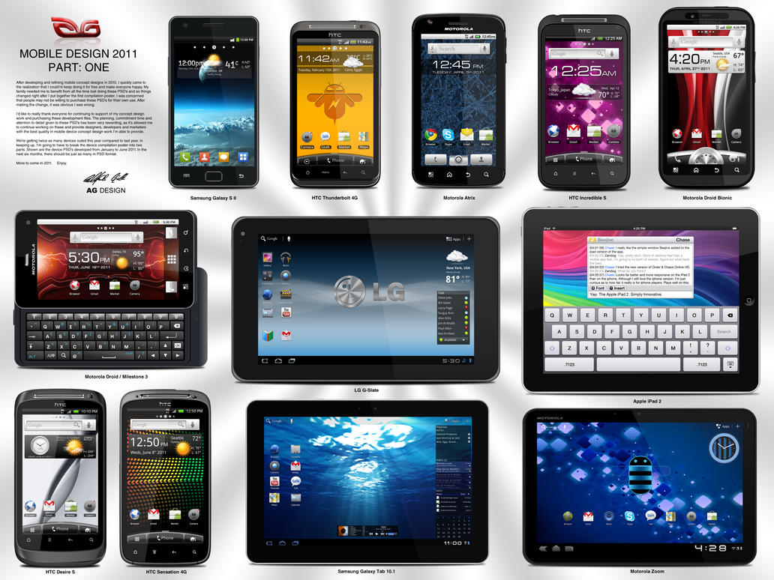
What is a mobile?
A mobile device is a handheld computer or smartphone designed for portability, making it compact and lightweight. These devices typically feature a flat LCD or OLED screen, a touchscreen interface, and digital or physical buttons. Examples of mobile devices include smartphones, tablets, e-readers, portable music players, smartwatches, and fitness trackers with smart capabilities.

Slide 4
Mobile Application
A mobile application (or mobile app) is a software application designed to run on smartphones, tablet computers and other mobile devices.
Mobile application development is the set of processes and procedures involved in writing software for small, wireless computing devices, such as smartphones and other hand-held devices.
Like web application development, mobile application development has its roots in more traditional software development. One critical difference, however, is that mobile apps are often written specifically to take advantage of the unique features of a particular mobile device.
a gaming app might be written to take advantage of the Phone's accelerometer or a mobile health app might be written to take advantage of a smartwatch's temperature
A mobile application, most commonly referred to as an app, is a type of application software designed to run on a mobile device, such as a smartphone or tablet computer.
Mobile applications frequently serve to provide users with similar services to those accessed on PCs.
Apps are generally small, individual software units with limited function.

Slide 5
Evolution of Mobile Applications
1st Generation
Pre-2000: Basic apps for calls, SMS, calculators, and simple games.
2nd Generation
(2000-2007): Feature phones with Java ME, BREW apps, and limited internet capabilities.
3rd Generation
(2007-2010): Introduction of smartphones with app stores (Android Market, Apple App Store).
4th Generation
(2010-2015): Cloud-connected apps, push notifications, and mobile commerce.
5th Generation
(2015-Present): AI-driven, AR/VR experiences, IoT integration, and seamless cross-platform applications.

Slide 6
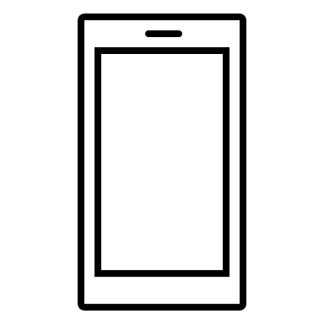
Types of Mobile Apps
Native Apps: applications developed specifically for a particular operating system (OS)
Mobile Web Apps: web applications optimized (responsive) for mobile devices.
Hybrid Apps: combine elements of both native and web applications.
Native App Code
Native Container
Browser
Android
iOS
Windows
etc.
App’s Web code
HTML 5
CSS
JS
App’s Web code

Slide 7
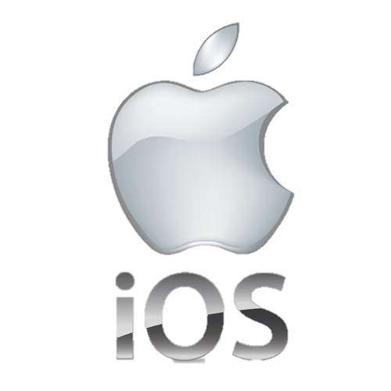
Mobile Platforms - iOS
iOS
Developed exclusively by Apple for its devices (iPhone, iPad, iPod Touch).
Closed ecosystem ensures high security and quality control.
Apps for iOS are developed using Swift or Objective-C programming languages. Developers use Xcode, Apple's integrated development environment (IDE), to create and test their apps.
Distributed solely through the Apple App Store.
Known for its clean and intuitive user interface. It uses a consistent design language called Human Interface Guidelines, which ensures a seamless user experience across all Apple devices.
iOS is optimized for performance, providing smooth and responsive interactions. Apple designs its own processors (A-series chips) to work seamlessly with iOS, ensuring efficient power management and high performance.

Slide 8
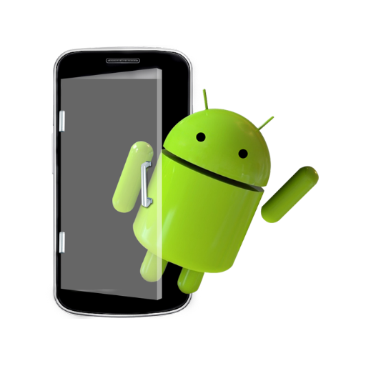
Mobile Platforms - Android
Android
Developed by Android Inc. and Bought by Google in 2005, Android is the most widely used mobile OS globally.
Open-source platform built on Linux, allowing extensive customization.
Primarily uses Java and Kotlin for app development.
Distributed through the Google Play Store and third-party stores.
Version numbers (before version 10) are associated alphabetically with desserts
Developers program using an API level associated with a specific version.

Slide 9
Mobile Platforms – Android (Cont.)
Android
It’s a powerful development framework that includes everything you need to build great apps using a mix of Java/Kotlin and XML.
Android does not use a Java Virtual Machine. Android does not use Abstract Window Toolkit or Swing library.
Android used Dalvik Virtual Machine (DVM), specialized VM and now is using ART –Android Runtime

Slide 10
Role of Design in Development
User Interface (UI): Visual elements like colors, typography, icons, and layouts.
Accessibility: Designing apps usable by people with disabilities (e.g., voice controls, high-contrast modes).
Prototyping & Wireframing: Visual blueprints for app structure and user flow, created using tools like Figma and Adobe XD.
Consistency: Maintaining design standards across devices and screen sizes.
User Experience (UX): Focus on intuitive navigation, functionality, and user satisfaction.

Slide 11
Trends in Mobile Application Development
Cross-Platform Development: Technologies like Flutter and React Native allow single codebases for Android and iOS.
5G Integration: Faster internet speeds enable richer multimedia apps and real-time data processing.
Artificial Intelligence & Machine Learning: Chatbots, recommendation systems, and predictive analytics.
Augmented Reality (AR) & Virtual Reality (VR): Interactive gaming, virtual tours, and retail experiences.
Internet of Things (IoT): Smart home devices, wearable tech, and interconnected ecosystems.
Progressive Web Apps (PWA): Blurring the line between web and native apps.

Slide 12
What are the primary advantages and disadvantages of Android and iOS?
How do modern design trends influence user engagement?
Which mobile development trend do you think will be most impactful in the next five years and why?
Discussion & Questions

Slide 13
Key Takeaways
Android and iOS are the leading mobile platforms.
Trends: Cross-platform development, AI, AR/VR, IoT, and 5G.
UX/UI design enhances usability; development ensures functionality.
Thank you

